Slide 1
CSIT988/CSIT488 Security, Ethics and Professionalism Week 3: Planning for Security
Notes:
Key Concepts of Information Security CIA triangle
Privacy
Identification
Authentication
Authorization
Accountability
Two basic approaches to management
Traditional management theory
Uses the core principles of planning, organizing, staffing, directing, and controlling (POSDC)
Popular management theory
Categorizes the principles of management into planning, organizing, leading, and controlling (POLC)

Slide 2
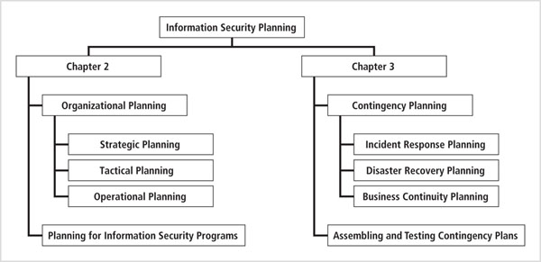
What Is Planning?

Slide 3
What is planning?
The process that develops, creates, and implements strategies for the accomplishment of objectives
Planning is creating action steps toward goals, and then controlling them
Planning provides direction for the organization’s future
In the top-down method, an organization’s leaders choose the direction
Planning begins with the general and ends with the specific
Notes:
Note that there are differences between leadership and management. A leader influences
employees so that they are willing to accomplish objectives. He or she is expected to lead by
example and demonstrate personal traits that instill a desire in others to follow. In other
words, leadership provides purpose, direction, and motivation to those who follow.
By comparison, a manager administers the resources of the organization. He or she creates budgets,
authorizes expenditures, and hires employees. This distinction between a leader and a manager
is important because leaders do not always perform a managerial function, whereas nonmanagers
are often assigned leadership roles. However, effective managers are also effective leaders.

Slide 4
Strategic Planning
What is Strategic Planning
Strategic planning involves the structured efforts of an organization to effectively identify its purposes for existing, the direction that the organization will pursue, and how that direction will allow the entity to achieve its short-term and long-term goals.
Individuals, businesses, governments, non-profit agencies, and any other type of organizations can utilize this process of strategically planning for the future. While the methods used in this type of planning process vary, there are a few basic steps that tend to apply in any setting.
Notes:
Note that there are differences between leadership and management. A leader influences
employees so that they are willing to accomplish objectives. He or she is expected to lead by
example and demonstrate personal traits that instill a desire in others to follow. In other
words, leadership provides purpose, direction, and motivation to those who follow.
By comparison, a manager administers the resources of the organization. He or she creates budgets,
authorizes expenditures, and hires employees. This distinction between a leader and a manager
is important because leaders do not always perform a managerial function, whereas nonmanagers
are often assigned leadership roles. However, effective managers are also effective leaders.

Slide 5
What is planning?
What is Tactical Planning
Tactical planning is the step taken after a business or team creates a strategic plan to break that plan into smaller objectives and goals.
A tactical plan is used to define goals and determine how they will be achieved through actions and steps. Most tactical plans outline specific steps or actions that will be taken to meet the goals of the larger strategic plan.
These actions or steps are then often delegated to the appropriate team members or employees to ensure they are met in a timely fashion.
In most cases, tactical planning is implemented when a business or team needs to respond to an immediate issue or situation. For example, a company that wants to win a bid from another business must create a viable proposal that will be successful.
Notes:
Note that there are differences between leadership and management. A leader influences
employees so that they are willing to accomplish objectives. He or she is expected to lead by
example and demonstrate personal traits that instill a desire in others to follow. In other
words, leadership provides purpose, direction, and motivation to those who follow.
By comparison, a manager administers the resources of the organization. He or she creates budgets,
authorizes expenditures, and hires employees. This distinction between a leader and a manager
is important because leaders do not always perform a managerial function, whereas nonmanagers
are often assigned leadership roles. However, effective managers are also effective leaders.

Slide 6
What is planning?
What is Operational Planning
Operational planning is a method a department or team uses to take the company’s strategic plan and turn it into a detailed map broken up into various components.
This map, called the operational plan, documents the team’s exact steps within specified time periods to reach each goal. Such a plan is made with a focus on the future to outline budget allocations, departmental activities and targets for the next year to three years.
The operational planning meaning becomes clearer when we understand that the operations segment is but one component of a larger strategic plan.
In operational planning, it’s essential to record each team member’s responsibilities for the fiscal year in detail. How detailed the plan is will depend upon the projected timeline for goal completion and how fast the team works.
Notes:
Note that there are differences between leadership and management. A leader influences
employees so that they are willing to accomplish objectives. He or she is expected to lead by
example and demonstrate personal traits that instill a desire in others to follow. In other
words, leadership provides purpose, direction, and motivation to those who follow.
By comparison, a manager administers the resources of the organization. He or she creates budgets,
authorizes expenditures, and hires employees. This distinction between a leader and a manager
is important because leaders do not always perform a managerial function, whereas nonmanagers
are often assigned leadership roles. However, effective managers are also effective leaders.

Slide 7
What is planning? Examples
PRODUCTION PLANNING
This type of operational planning in management is achieved towards mapping a business’s output. Here the focus is primarily on using labor and capital intelligently to make products that can be sold profitably. Take, for instance, a frozen yogurt manufacturer that creates 10 different flavors within just one facility. Operational planning here will involve organizing supplies and streamlining production lines, work shifts and warehouse space to maintain manageable overhead costs.
Notes:
Note that there are differences between leadership and management. A leader influences
employees so that they are willing to accomplish objectives. He or she is expected to lead by
example and demonstrate personal traits that instill a desire in others to follow. In other
words, leadership provides purpose, direction, and motivation to those who follow.
By comparison, a manager administers the resources of the organization. He or she creates budgets,
authorizes expenditures and hires employees. This distinction between a leader and a manager
is important because leaders do not always perform a managerial function, whereas nonmanagers
are often assigned leadership roles. However, effective managers are also effective leaders.

Slide 8
What is planning? Examples
CAPABILITY PLANNING
Operational planning is required to identify the purpose of a business and then create a roadmap for building on its capabilities. For example, a private taxi company evaluating its own business capabilities will devise a plan to maintain its fleet better and upgrade operations to enhance the safety of women passengers.
Notes:
Note that there are differences between leadership and management. A leader influences
employees so that they are willing to accomplish objectives. He or she is expected to lead by
example and demonstrate personal traits that instill a desire in others to follow. In other
words, leadership provides purpose, direction, and motivation to those who follow.
By comparison, a manager administers the resources of the organization. He or she creates budgets,
authorizes expenditures, and hires employees. This distinction between a leader and a manager
is important because leaders do not always perform a managerial function, whereas nonmanagers
are often assigned leadership roles. However, effective managers are also effective leaders.

Slide 9
What is planning? Examples
SALES PLANNING
Operational planning is crucial for matching sales targets with production capabilities. For instance, if a makeup brand wants to run a promotional campaign that could grow sales by 150%, only tight operational planning will be able to determine whether the company’s factories can boost production to such a degree.
Going over a few key examples of operational planning in management would be helpful to examine how the process actually helps. Let’s look at a few benefits of operational planning.
Notes:
Note that there are differences between leadership and management. A leader influences
employees so that they are willing to accomplish objectives. He or she is expected to lead by
example and demonstrate personal traits that instill a desire in others to follow. In other
words, leadership provides purpose, direction, and motivation to those who follow.
By comparison, a manager administers the resources of the organization. He or she creates budgets,
authorizes expenditures, and hires employees. This distinction between a leader and a manager
is important because leaders do not always perform a managerial function, whereas nonmanagers
are often assigned leadership roles. However, effective managers are also effective leaders.

Slide 10
BENEFITS OF OPERATIONAL PLANNING
Without operational planning in management, businesses would run inefficiently and incur losses. Planned operations are a company’s lifeblood. Here are some key benefits of operational planning.
PROVIDES CLARITY
Among other things, operational planning ensures everyone on the team has a clear idea about the work to be done on a monthly, weekly and even daily basis. This helps maintain focus and increase efficiency.
Notes:
Note that there are differences between leadership and management. A leader influences
employees so that they are willing to accomplish objectives. He or she is expected to lead by
example and demonstrate personal traits that instill a desire in others to follow. In other
words, leadership provides purpose, direction, and motivation to those who follow.
By comparison, a manager administers the resources of the organization. He or she creates budgets,
authorizes expenditures, and hires employees. This distinction between a leader and a manager
is important because leaders do not always perform a managerial function, whereas nonmanagers
are often assigned leadership roles. However, effective managers are also effective leaders.

Slide 11
BENEFITS OF OPERATIONAL PLANNING
Without operational planning in management, businesses would run inefficiently and incur losses. Planned operations are a company’s lifeblood. Here are some key benefits of operational planning.
PROVIDES A ROADMAP
Achieving long-term goals becomes much easier with operational planning. Productivity increases when team members have a detailed plan to follow; this also helps maintain accountability.
Notes:
Note that there are differences between leadership and management. A leader influences
employees so that they are willing to accomplish objectives. He or she is expected to lead by
example and demonstrate personal traits that instill a desire in others to follow. In other
words, leadership provides purpose, direction, and motivation to those who follow.
By comparison, a manager administers the resources of the organization. He or she creates budgets,
authorizes expenditures, and hires employees. This distinction between a leader and a manager
is important because leaders do not always perform a managerial function, whereas nonmanagers
are often assigned leadership roles. However, effective managers are also effective leaders.

Slide 12
BENEFITS OF OPERATIONAL PLANNING
Without operational planning in management, businesses would run inefficiently and incur losses. Planned operations are a company’s lifeblood. Here are some key benefits of operational planning.
REDUCES DELAY
With a clearly charted-out path, employees know how much ground they have to cover by the end of each day. This helps them manage their time better and stay on schedule, thereby producing quality and timely work.
Notes:
Note that there are differences between leadership and management. A leader influences
employees so that they are willing to accomplish objectives. He or she is expected to lead by
example and demonstrate personal traits that instill a desire in others to follow. In other
words, leadership provides purpose, direction, and motivation to those who follow.
By comparison, a manager administers the resources of the organization. He or she creates budgets,
authorizes expenditures, and hires employees. This distinction between a leader and a manager
is important because leaders do not always perform a managerial function, whereas nonmanagers
are often assigned leadership roles. However, effective managers are also effective leaders.

Slide 13
The Role of Planning
Successful organizations utilize planning
Planning involves
Employees
Management
Stockholders
Other outside stakeholders
The physical and technological environment
The political and legal environment
The competitive environment

Slide 14
The Role of Planning
Strategic planning includes:
Values statement
Vision statement
Mission statement
Strategy
Coordinated plans for sub units
Knowing how the general organizational planning process works helps in the information security planning process
The values, vision, and mission statements together provide the foundation for planning

Slide 15
Values Statement
Establishes organizational principles and qualities (WHY)
Makes organization’s conduct standards clear
Random Widget Works values commitment, honesty, integrity and social responsibility among its employees, and is committed to providing its services in harmony with its corporate, social, legal and natural environments

Slide 16
Vision Statement
The vision statement expresses what the organization wants to become (WHAT)
Vision statements should be ambitious
Random Widget Works will be the preferred manufacturer of choice for every business’s widget equipment needs, with an RWW widget in every machine they use

Slide 17

Vision Statement

Slide 18
Mission Statement
Mission statement (HOW)
Declares the business of the organization and its intended areas of operations
Explains what the organization does and for whom Random Widget Works, Inc. designs and manufactures quality widgets and associated equipment and supplies for use in modern business environments

Slide 19
Mission Statement
A mission statement should be
concise
should reflect both internal and external operations
should be robust enough to remain valid for a period of four to six years.
Simply put, the mission statement must explain what the organization does and for whom.

Slide 20
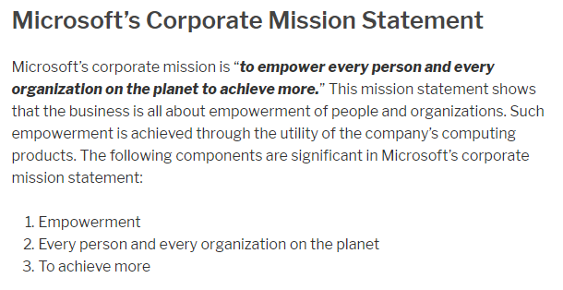
Mission Statement

Slide 21
Mission, Vision and Values Statement
The mission statement is the follow-up to the vision statement. If the vision statement states where the organization wants to go, the mission statement describes how it wants to get there.
Taken together, the mission, vision, and values statements provide the philosophical foundation for planning and guide the creation of the strategic plan.

Slide 22
Strategic Planning
Strategy is the basis for long-term direction
Strategic planning guides organizational efforts
Focuses resources on clearly defined goals
“… strategic planning is a disciplined effort to produce fundamental decisions and actions that shape and guide what an organization is, what it does, and why it does it, with a focus on the future.”

Slide 23
Strategic Planning
Strategic plans formed at the highest levels of the organization are translated into more specific strategic plans for intermediate layers of management.
These plans are then converted into tactical planning for supervisory managers and eventually provide direction for the operational plans undertaken by the nonmanagement members of the organization.
This multilayered approach encompasses two key objectives: general strategy and overall strategic planning.
First, general strategy is translated into specific strategy; second, overall strategic planning is translated into lower-level tactical and operational planning.

Slide 24
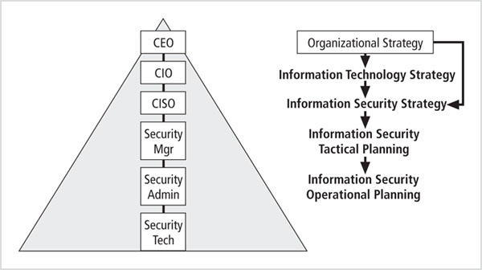
Creating a Strategic Plan
CEO: Chief Executive Officers
CIO: Chief Information Officers
CISO: Chief Information Security Officers
COO: Chief Operations Officers

Slide 25
Creating a Strategic Plan
An organization develops a general strategy
Then creates specific strategic plans for major divisions
Each level or division translates those objectives into more specific objectives for the level below
CEO (general statement of strategy): Providing the highest quality health care service in the industry.

Slide 26
Creating a Strategic Plan
To execute this broad strategy executives must define individual managerial responsibilities
To response the CEO,
CIO: Providing high-level health care information service in support of the highest quality health care service in the industry.
COO: Providing the highest quality medical services
CISO: Ensuring that quality health care information services are provided securely and in compliance with all local, state, and federal information processing, information security, and privacy statutes, including HIPAA.
Notes:
Health Insurance Portability and Accountability Act
The Privacy Act 1988 is largely the Australian counterpart to HIPAA.

Slide 27
Planning Levels
Strategic goals are translated into tasks
Objectives should be specific, measurable, achievable, reasonably high and time-bound (SMART)
Strategic planning then begins a transformation from general to specific objectives
Strategic plans are used to create tactical plans and then operational plans.

Slide 28
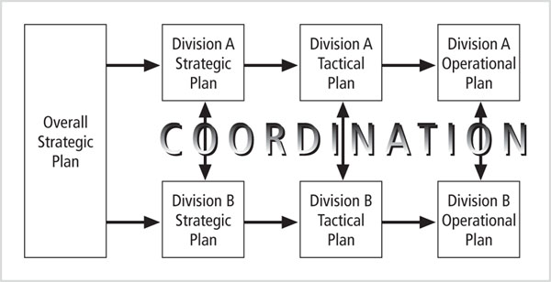
Planning Levels

Slide 29
Planning Levels
Tactical Planning
Has a shorter focus (1-5 years) than strategic planning
Breaks applicable strategic goals into a series of incremental objectives
Each objective should be specific and have a delivery date.
Budgeting, resource allocation, personnel are critical components for tactical plan
Including project plans, resource acquisition planning documents, project budgets, project reviews, and regular reports.
To organize, prioritize and acquire resources to support the overall strategic plan.

Slide 30
Planning Levels
Operational Planning
Used by managers and employees to organize the ongoing, day-to-day performance of tasks
Includes clearly identified coordination activities across department boundaries such as:
Communications requirements
Weekly meetings
Summaries
Progress reports
Associated tasks

Slide 31
Planning and the CISO
Elements of a strategic plan
Executive summary
Mission statement and vision statement
Organizational profile and history
Strategic issues and core values
Program goals and objectives
Management/operations goals and objectives
Appendices (optional)

Slide 32
Planning and the CISO
Tips for creating a strategic plan (Brian Ward)
Create a compelling vision statement that frames the evolving plan, and acts as a magnet for people who want to make a difference
Embrace the use of the balanced scorecard approach
Deploy a draft high level plan early, and ask for input from stakeholders in the organization

Slide 33
Planning and the CISO
Tips for creating a strategic plan (cont’d.)
Make the evolving plan visible
Make the process invigorating for everyone
Be persistent
Make the process continuous
Provide meaning
Be yourself
Lighten up and have some fun

Slide 34
Information Security Governance
Strategic planning and corporate responsibility are accomplished by using governance, risk management, and compliance (GRC).
GRC integrate them into one holistic approach for executive-level strategic planning and management.
Governance of InfoSec is a strategic planning responsibility
Importance has grown in recent years
Information security objectives must be addressed at the highest levels of an organization's management team
To be effective and offer a sustainable approach
Notes:
Strategic planning and corporate responsibility is best accomplished using an approach many call governance, risk management, and compliance (GRC). GRC seeks to integrate these three, previously separate responsibilities into one holistic approach that can provide sound executive-level strategic planning and management of the InfoSec function. Governance is cov- ered in the following section; risk management is covered in Chapters 8 and 9; compliance to regulations is covered in Chapter 12. The subjects themselves are neither new nor unique to InfoSec; however, the recognition of the need to integrate the three at the executive level is becoming increasingly important to practitioners in the field.

Slide 35
Information Security Governance
Information security governance includes (ITGI)
Providing strategic direction
Establishing objectives
Measuring progress toward those objectives
Verifying that risk management practices are appropriate
Validating that the organization’s assets are used properly
Notes:
Information Technology Governance Institute (ITGI)

Slide 36
Information Security Governance
Actions of the Board of Directors
Inculcating a culture that recognizes the importance of information security
Aligning management’s investment in information security with organizational strategies and risk environment
Assuring comprehensive development and implementation of an information security program
Demanding reports from the various layers of management on the information security program’s effectiveness and adequacy

Slide 37
Desired Outcomes
Outcomes of information security governance
Strategic alignment of information security with business strategy to support organizational objectives
Risk management to reduce potential impacts on information resources
Resource management with efficient use of information security knowledge and infrastructure
Performance measurement to ensure that organizational objectives are achieved
Value delivery by optimizing information security investments in support of organizational objectives

Slide 38
Desired Outcomes
Recommended Board of Director practices (National Association of Corporate Directors – NACD, USA)
Place information security on the board’s agenda
Identify information security leaders, hold them accountable and ensure support for them
Ensure the effectiveness of the corporation’s information security policy through review and approval
Assign information security to a key committee and ensure adequate support for that committee

Slide 39
Benefits of Information Security Governance
An increase in share value for organizations
Increased predictability and reduced uncertainty of business operations by lowering information-security-related risks to definable and acceptable levels
Protection from the increasing potential for civil or legal liability as a result of information inaccuracy or the absence of due care
Optimization of the allocation of limited security resources
Assurance of effective InfoSec policy and policy compliance

Slide 40
Benefits of Information Security Governance
A firm foundation for efficient and effective risk management, process improvement, and rapid incident response
A level of assurance that critical decisions are not based on faulty information
Accountability for safeguarding information during critical business activities, such as mergers and acquisitions, business process recovery, and regulatory response

Slide 41
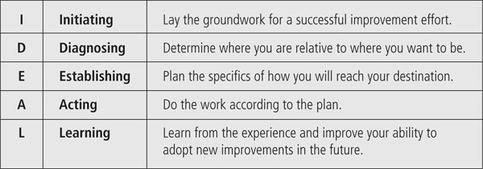
Implementing Information Security Governance
IDEAL model

Slide 42
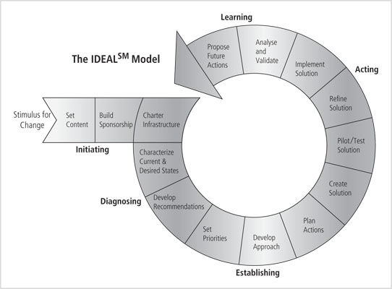
Implementing Information Security Governance

Slide 43
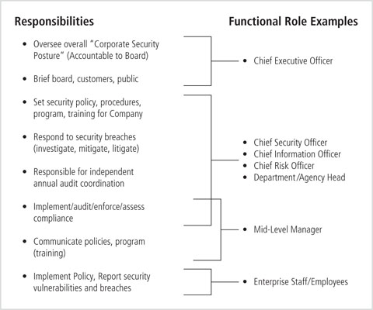
Planning for Information Security Implementation
Notes:
each link in this
chain of projects could be a specific project. Note that each project is to be guided by a security
systems development life cycle (SecSDLC) methodology, as will be described in later chapters.

Slide 44
Planning For Information Security Implementation
Roles of the CIO and CISO
Translating overall strategic plan into tactical and operational information security plans
The CISO plays a more active role in the development of the planning details than does the CIO

Slide 45
Planning For Information Security Implementation
CISO Job Description (example)
Creates a strategic information security plan with a vision for the future of information security
Understands the fundamental business activities and suggests appropriate information security solutions to protect these activities
Develops action plans, schedules, budgets, and status reports

Slide 46
Planning For Information Security Implementation
Implementation can begin
After plan has been translated into IT and information security objectives and tactical and operational plans
Methods of implementation
Bottom-up: use technical expertise of the individual. Lack of coordination
Top-down: high-level managers provide resources, give direction, issue policies, indicate goals and outcomes, determine responsibilities
System development life cycle (SDLC)

Slide 47
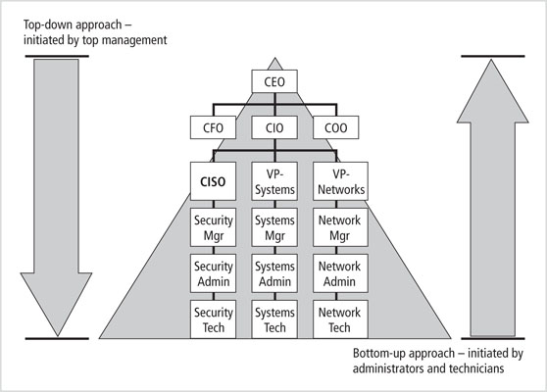
Planning For Information Security Implementation

Slide 48
Introduction to the Security Systems Development Life Cycle
An SDLC is a methodology for the design and implementation of an information system
SDLC-based projects may be initiated by events or planned
At the end of each phase, a review occurs to determine if the project should be continued, discontinued, outsourced, or postponed

Slide 49
Introduction to the Security Systems Development Life Cycle
SecSDLC methodology is similar to SDLC
Identification of specific threats and the risks they represent
Design and implementation of specific controls to counter those threats and manage risks posed to the organization

Slide 50
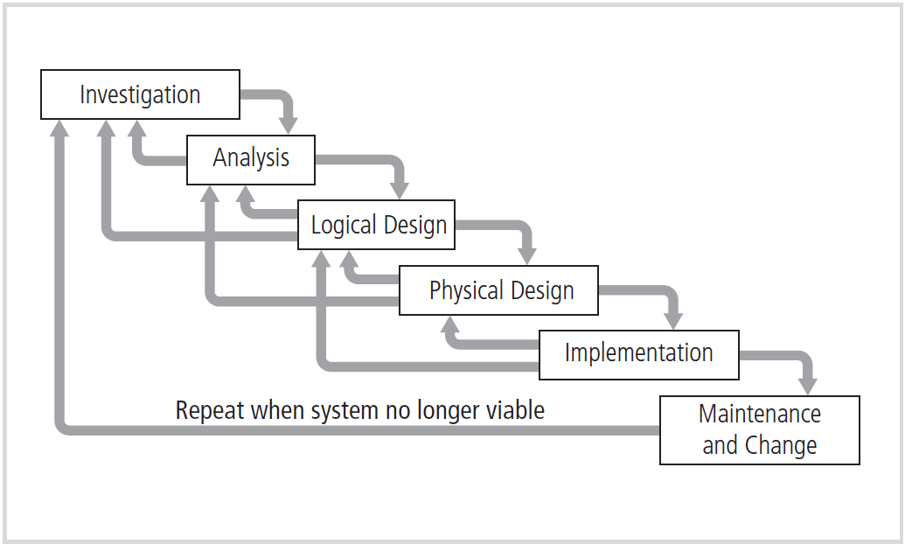
Introduction to the Security Systems Development Life Cycle

Slide 51
Investigation in the SecSDLC
Phase begins with directive from management specifying the process, outcomes, and goals of the project and its budget
Frequently begins with the affirmation or creation of security policies
Teams assembled to analyze problems, define scope, specify goals and identify constraints
Feasibility analysis
Determines whether the organization has the resources and commitment to conduct a successful security analysis and design

Slide 52
Analysis in the SecSDLC
Prepare analysis of existing security policies and programs, along with known threats and current controls
Analyze relevant legal issues that could affect the design of the security solution
Risk management begins in this stage
The process of identifying, assessing, and evaluating the levels of risk facing the organization, specifically the threats to the information stored and processed by the organization
A threat is an object, person, or other entity that represents a constant danger to an asset

Slide 53
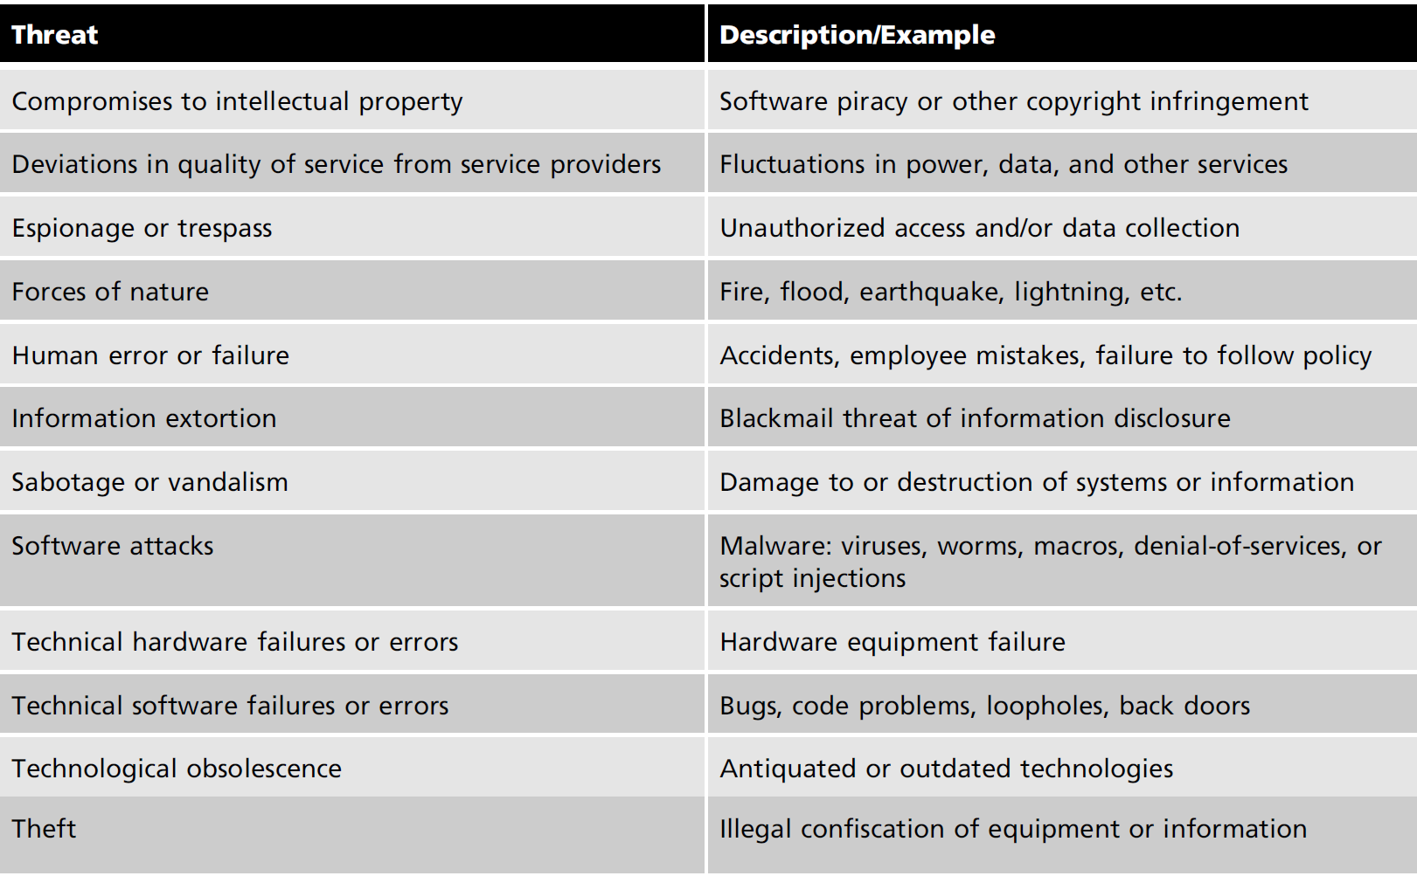
Threats to information security

Slide 54
Threats to information security
An attack
A deliberate act that exploits a vulnerability to achieve the compromise of a controlled system
An identified weakness of a controlled system in which necessary controls that are not present or are no longer effective
Accomplished by a threat agent that damages or steals an organization’s information or physical assets
An exploit
A technique or mechanism used to compromise a system

Slide 55
Threats to information security
Some common attacks
Malicious code: virus
Hoaxes: false threat
Back doors: bypassing access control
Password crack: guess a password
Brute force: try every possible
Dictionary: list of values
Denial-of-service (DoS) and distributed denial-of-service (DDoS)
Notes:
A Denial-of-Service (DoS) attack is an attack meant to shut down a machine or network, making it inaccessible to its intended users. DoS attacks accomplish this by flooding the target with traffic, or sending it information that triggers a crash.

Slide 56
Threats to information security
Some common attacks (cont’d.)
Spoofing: unauthorized access
Man-in-the-middle
Spam
Mail bombing
Sniffer
Social engineering: convince people
Buffer overflow
Timing: observing the time

Slide 57
Threats to information security
Prioritize the risk posed by each category of threat
Identify and assess the value of your information assets
Assign a comparative risk rating or score to each specific information asset

Slide 58
Design in the SecSDLC (logical, physical)
Create and develop a blueprint for security
Examine and implement key policies
Evaluate the technology needed to support the security blueprint
Generate alternative solutions
Agree upon a final design

Slide 59
Design in the SecSDLC
Security models may be used to guide the design process
Models provide frameworks for ensuring that all areas of security are addressed
Organizations can adapt or adopt a framework to meet their own information security needs

Slide 60
Design in the SecSDLC
A critical design element of the information security program is the information security policy
Management must define three types of security policy
Enterprise information security policies
Issue-specific security policies
Systems-specific security policies

Slide 61
Design in the SecSDLC
SETA program consists of three elements
Security education, security training, and security awareness
The purpose of SETA is to enhance security by
Improving awareness
Developing skills and knowledge
Building in-depth knowledge
Notes:
Another integral part of the InfoSec program is the SETA program, discussed in detail in Chapter 5. Part of the CISO’s responsibilities, the SETA program is a control measure designed to reduce accidental security breaches by employees.

Slide 62
Design in the SecSDLC
Design controls and safeguards
Used to protect information from attacks by threats
Three categories of controls: managerial, operational and technical
Managerial controls
Address the design and implementation of the security planning process, security program management, risk management, and security control reviews
Notes:
The design phase continues with the formulation of the controls and safeguards used to pro- tect information from attacks by threats.

Slide 63
Design in the SecSDLC
Operational controls cover management functions and lower level planning
Disaster recovery
Incident response planning
Personnel security
Physical security
Protection of production inputs and outputs

Slide 64
Design in the SecSDLC
Technical controls
Address tactical and technical issues related to designing and implementing security in the organization
Technologies necessary to protect information are examined and selected

Slide 65
Design in the SecSDLC
Contingency planning
Prepare, react and recover from circumstances that threaten the organization
Types of contingency planning
Incident response planning (IRP)
Disaster recovery planning (DRP)
Business continuity planning (BCP)
Notes:
Another element of the design phase is the creation of essential preparedness documents. Managers in the IT and InfoSec communities engage in strategic planning to assure the con- tinuous availability of the organization’s information systems. In addition, managers of the organization must be ready to respond when an attack occurs. The various plans for han- dling attacks, disasters, or other types of incidents include business continuity plans, disaster recovery plans (DRPs), and incident response plans (IR plans). These are often known collectively as contingency plans.

Slide 66
Design in the SecSDLC
Physical security
Design, implementation, and maintenance of countermeasures that protect the physical resources of an organization
Physical resources include
People
Hardware
Supporting information system elements

Slide 67
Implementation in the SecSDLC
Security solutions are acquired, tested, implemented, and tested again
Personnel issues are evaluated and specific training and education programs conducted
Management of the project plan
Planning the project
Supervising the tasks and action steps within the project
Wrapping up the project

Slide 68
Implementation in the SecSDLC
Members of the development team
Champion
Team leader
Security policy developers
Risk assessment specialists
Security professionals
Systems administrators
End users

Slide 69
Implementation in the SecSDLC
Staffing the information security function
Decide how to position and name the security function
Plan for the proper staffing of the information security function
Understand the impact of information security across every role in IT
Integrate solid information security concepts into the personnel management practices of the organization

Slide 70
Implementation in the SecSDLC
Information security professionals
Chief information officer (CIO)
Chief information security officer (CISO)
Security managers
Security technicians
Data owners
Data custodians
Data users

Slide 71
Maintenance and change in the SecSDLC
Once the information security program is implemented, it must be operated, properly managed, and kept up to date by means of established procedures
If the program is not adjusting adequately to the changes in the internal or external environment, it may be necessary to begin the cycle again

Slide 72
Maintenance and change in the SecSDLC
Aspects of a maintenance model
External monitoring
Internal monitoring
Planning and risk assessment
Vulnerability assessment and remediation
Readiness and review
Vulnerability assessment

Slide 73
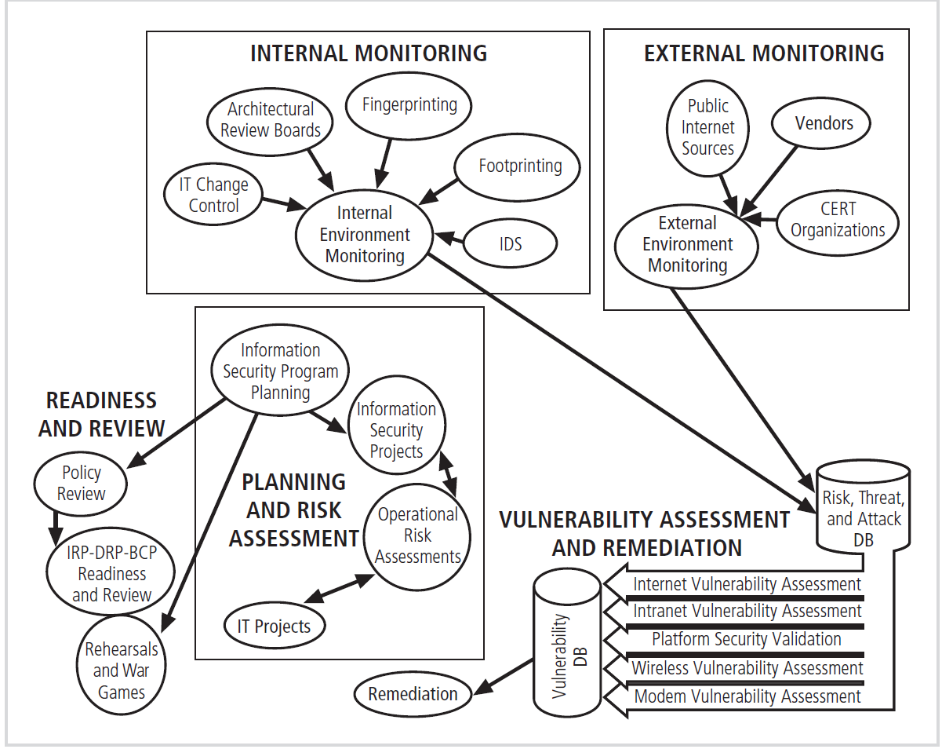
Maintenance and change in the SecSDLC

